Slide 1

Israel Public Transportation
Detailed Design
NAYA College
Data Engineering Course Project
Guy Levinhr
Meirav Mazala
December 2020

Slide 2
Agenda:
1
Scope and Project Motivation
2
Architecture Overview
3
Findings
4
Data Flow Demo
Data Engineering- Turn your Data into Knowledge

Slide 3
Scope and Project Motivation:
Israeli public transportation, Service Interface for Real time Information, share the following data:
Plan for the next week transportation arrival- Date, time and location- this data saved every night as CSV files and updated for the next week.
Actual Real time Data- Current location of the vehicles and their attributes (ID, Line, code..)
The Goal of this Project is to collect, combine, filter, enrich and organize the data to be used for analysis.
Based on this data, we can compare the plan vrs the actual and get material conclusions about the delays in the transportation agencies.
Data Engineering- Turn your Data into Knowledge

Slide 4
Architecture Overview:
Two data sources are available:
CSV files- for the forecast- planed paths- Night
Real time data updated all the time with the location and time of each bus id- Real time.
The data will be combined, filtered, organized, calculated and enriched with additional information such as arrived to the station and define when its arrived.
Last part is the analysis and conclusions from the data.
Data Engineering- Turn your Data into Knowledge

Slide 5





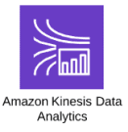






Nightly Task
Generator

Slide 6
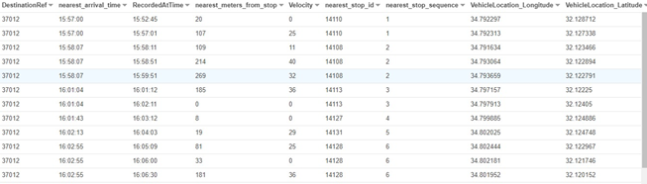
Athena’s output:
In this table exported from Athena, we see:
Planed arrival time
Actual arrival time to the station
Distance from station
Velocity
Stop id
Location on path
Data Engineering- Turn your Data into Knowledge

Slide 7
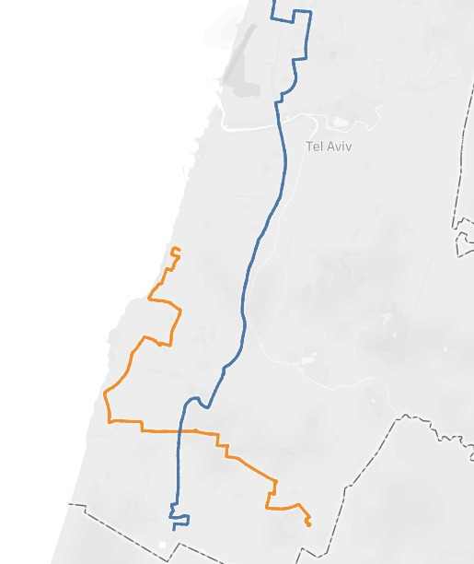
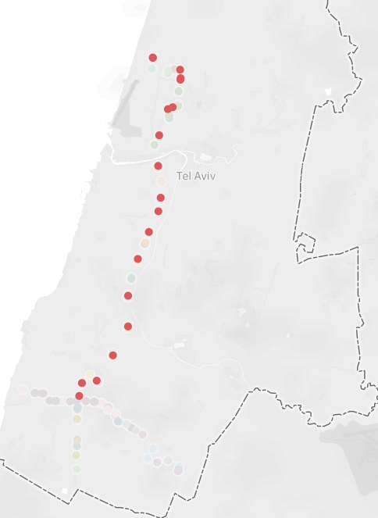
Visualization - Tableau:
Line 171 Blue path, line 88 Orange path
Data Engineering- Turn your Data into Knowledge

Slide 8
Findings :
Making this data available to use, answer many questions about the frequency and time of delays.
The Israel public transportation can use it for alerts, enforce the agreements with the agencies obligations and mostly to improve the services.
Turn your Data into Knowledge!
Data Engineering- Turn your Data into Knowledge

Slide 9
Data Flow Demo:
Data Engineering- Turn your Data into Knowledge

Slide 10
Thank You!
Data Engineering- Turn your Data into Knowledge

